Slide 1
Crime Analysis
Detailed Project Report
Taniya Nath
Data Science Bootcamp | iNeuron
May 2022

Slide 2
Project Details
Project Title
Crime Analysis in Boston
Technology
Business Intelligence
Domain
Security
Project Difficulty level
Difficult
Programming Language
Python
Tools
Jupyter Notebook, MS Excel, Tableau

Slide 3
Objectives
The goal of this project is to investigate Crime incident reports which are provided by Boston Police Department (BPD) to document the initial details surrounding an incident to which BPD officers respond.

Slide 4
Problem Statement
Crime analysis is a law enforcement duty that involves a systematic investigation of patterns and trends in crime and disorder. Pattern information can help law enforcement organizations deploy resources more effectively and aid detectives in locating and apprehending criminals.
This is a dataset containing records from the new crime incident report system, which includes a reduced set of fields focused on capturing the type of incident as well as when and where it occurred.

Slide 5
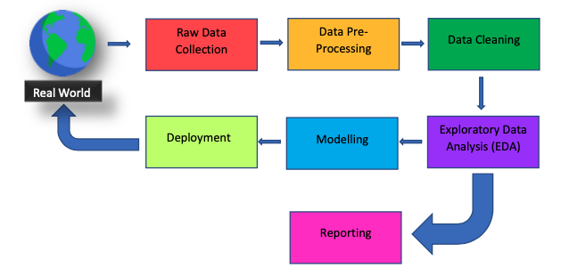
Architecture

Slide 6
Dataset Information
INCIDENT_NUMBER: The id of the crime committed. It is unique value for each crime.
OFFENSE_CODE: It shows code of crime types.
OFFENSE_CODE_GROUP: General crime types.
OFFENSE_DESCRIPTION: Detailed explanation of the crime.
DISTRICT: District name where the crime occurred.
REPORTING_AREA: Area number that crime reported.
YEAR: the year that crime occured. (2015,2016,2017,2018)
MONTH: the month that crime occured.
DAY OF WEEK: the week that crime occured.
HOUR: the hour that crime occured.
UCR_PART: Uniform Crime Reporting Offence types. Part 1 contains the most dangerous and important crimes.
STREET: the street where crime occured.
LAT: the latitude where the crime occurred.
LONG: the longitude where the crime occurred.
LOCATION: the location where the crime occurred.(include latitude and longitude)

Slide 7
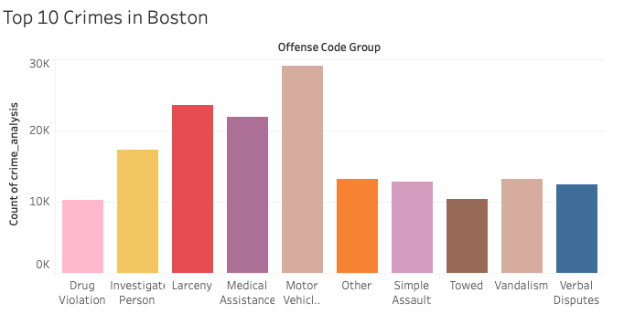
Data Analysis – Visualization and Insights
1. Top 10 Crimes in Boston
Here, we can see the crime incident that has happened the most frequently in Boston is “Motor Vehicle Accident Response,” and “Larceny” has also been taking place very frequently.

Slide 8
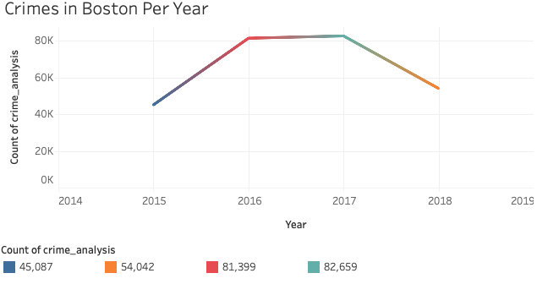
Data Analysis – Visualization and Insights
2. Percentage of Crimes per Year in Boston
In 2017 Crime rate was more whereas In 2015 Crime rate is less in Boston.

Slide 9
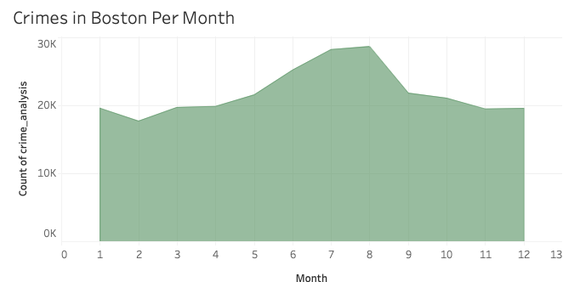
Data Analysis – Visualization and Insights
3. Major Crime in Boston Per Month
In the month of July and August the Crime rate is very high in Boston.

Slide 10
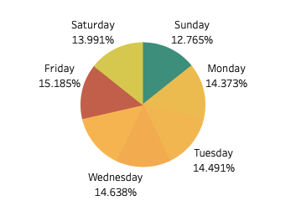
Data Analysis – Visualization and Insights
Crime rate is high on Friday in Boston. It seems that the crime was triggered by the fact that many people were out on Friday night due to Saturday being a holiday. Other days there is no significant difference, but Sunday has the lowest rate. Also, the fact that most of the people spend their Sunday at home may be a factor that reduces crime.
5. Major Crime in Boston Per Day

Slide 11
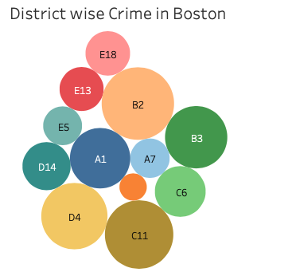
Data Analysis – Visualization and Insights
6. District wise Crime in Boston
B2,C11,D4 and A1 districts has the majority crime numbers in Motor Vehicle Accident, and Larcency.

Slide 12
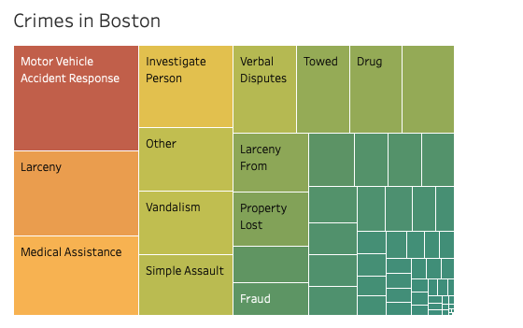
Data Analysis – Visualization and Insights
7. Crimes in Boston
There were various types of crime which took place in Boston. They are like Motor Vehicle Accident, Larceny, Medical Assistance, Vandalism, Simple Assault, Towed, Drug etc.

Slide 13
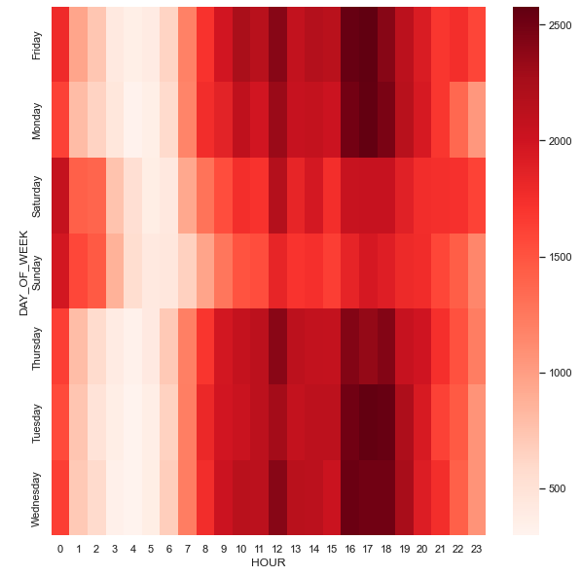
Data Analysis – Visualization and Insights
8. Major Crimes in Boston Per Day and Hour
Let's look at the time variable. The crime rate increases at noon (12:00) and after work hours (16: 00,17: 00,18: 00) on weekdays. The crime rate increases at 00:00 on weekends, i.e Fridays, Saturdays and Sundays.

Slide 14
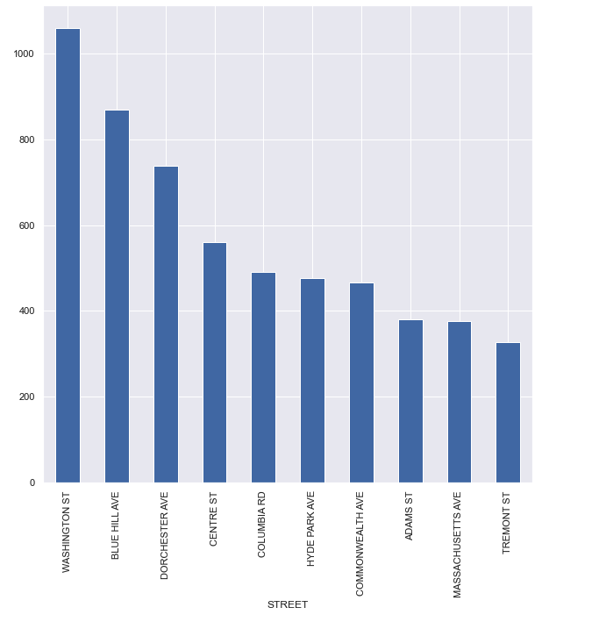
Data Analysis – Visualization in Python
8. Analyzing Motor Vehicle Accident Response in different location
Looking at the result we can see the top 10 locations in Boston where Motor Vehicle Accident Response is more likely to happen are BLUE HILL AVE, WASHINGTON ST and DORCHESTER AVE.

Slide 15
Key Performance Indicators (KPI)
Crimes in Boston
Top 10 Crimes in Boston
Percentage of Crimes per Year in Boston
Major Crime in Boston Per Month
Major Crime in Boston Per Day
District wise Crime in Boston
Major Crimes in Boston Per Day and Hour
Analyzing Motor Vehicle Accident Response in different location

Slide 16
Conclusion
The Top most Crime incident that has frequently in Boston is Motor Vehicle Accident Response and Larcency.
In 2017 Crime rate was more whereas In 2015 Crime rate is less in Boston.
In the month of July and August the Crime rate is very high in Boston.
Crime rate is high on Friday in Boston i.e, 15.185%
B2,C11,D4 and A1 districts has the majority crime numbers in Motor Vehicle Accident, and Larcency.
The crime rate increases at noon and after work hours on weekdays.
The crime rate increases at midnight on weekends, i.e Fridays, Saturdays and Sundays.
The top 10 locations in Boston where Motor Vehicle Accident Response is more likely to happen are BLUE HILL AVE, WASHINGTON ST and DORCHESTER AVE.

Slide 17
FAQ
Q1) What’s the source of data?
The Dataset was taken from iNeuron’s Provided Project Description Document.
https://data.boston.gov/dataset/crime-incident-reports-august-2015-to-date-source-new-system
Q2) What was the type of data?
The data was the combination of numerical and Categorical values.
Q 3) What’s the complete flow you followed in this Project?
Please refer slide 5th for better Understanding
Q4) What techniques were you using for data?
Removing unwanted attributes
- Visualizing relation of independent variables with each other and output variables
- Cleaning data and imputing if null values are present.
Converting Numerical data into Categorical values.
Finding the Correlation among the attributes.
Q 6) What were the libraries that you used in Python?
I used Pandas, NumPy and Matplotlib and Seaborn libraries in Pandas.

